Slide 1
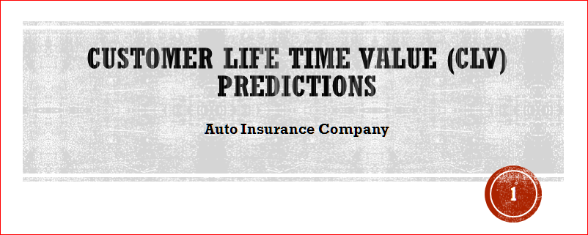

Slide 2


Slide 3
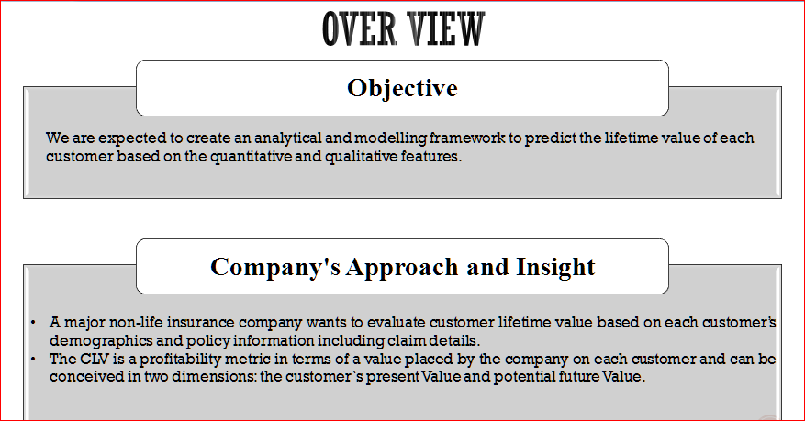

Slide 4
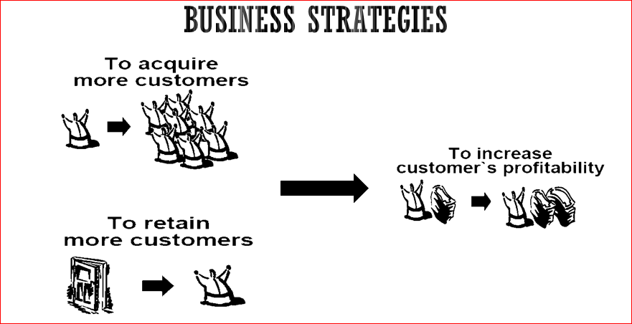
HIGHER RETENTION RATE AND CONSISTENT ACQUISITION RATE

Slide 5
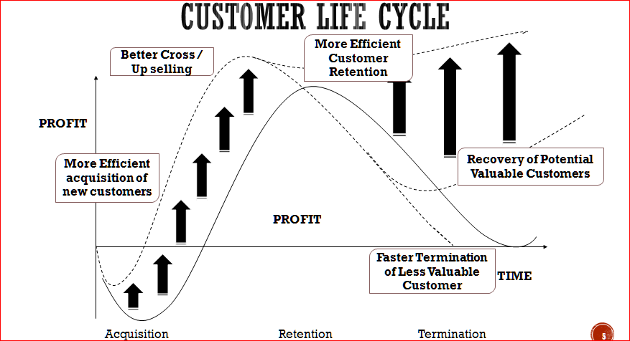

Slide 6
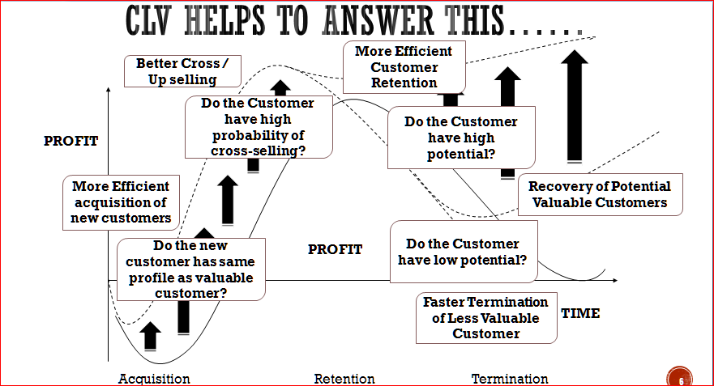

Slide 7
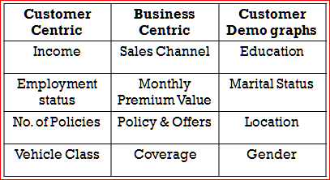
FEATURE ENGINEERING AND DRAWING SOME IMPORTANT OBSERVATIONS
I found strong correlation between some continuous features: Total Claim Amount and
Monthly Premium Auto. Income and Total Claim Amount. I can’t discard any of those features.
Present Value of Customer:
Monthly Premium Auto*Month Since Policy Inception-Total Amount Claim
Total Observations: 9134
Total Variables: 24
Target feature: CLV
Split: 75-25
Scaling: Based on the model
Evaluation metric: R-suared

Slide 8
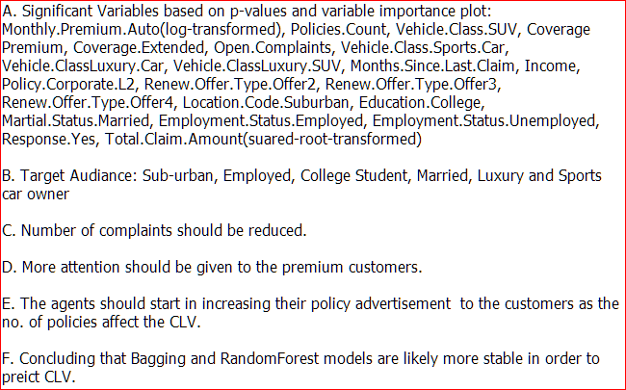
CONCLUSION AND DRAW INSIGHTS

